Slide 2
welcome
to women in print
Notes:
PHIL TO MOVE SLIDE AT 5MINS TO SPEAKERS – PLEASE TAKE YOUR SEATS FOR THE FORMAL PRESENTATIONS

Slide 3
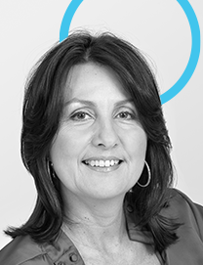
Susan Heaney chairperson/women in print md/heaney’s performers in print
Notes:
Welcome and good morning to you all, I am Susan Heaney, Chairperson and Found of Women in Print, it is great to be with you all today. Women in Print acknowledges and pays respect today to the past, present and future Traditional Custodians and Elders of this nation and the continuation of cultural, spiritual and educational practices of Aboriginal and Torres Strait Islander peoples. Before I introduce you to this topic I do want to thank all our sponsors that you saw on the intro slides as you came in. Media Super, long-term Partners of Women in Print, as well as all the Platinum Partners – Cactus Imaging, DIC, Fujifilm, Heidelberg, IVE Group, Kwik Kopy, Ovato, Ricoh and providing this room, breakfast and much more today, our firm partners – Visual Connections. We simply couldn’t bring these events to life without sponsors and if there are any of you in the room who would like to add your company logo to that very powerful group of leading companies I have just mentioned, please reach out to us, we would love to have your support also. So to today, this is our first event inviting men as guests to discuss a very important topic that our industry must address – gender equality across the workplace. This is a topic Women in Print has raised across our breakfast series this year and from those discussions developed an industry policy across this matter. We recognise this is not an immediate, one size fits all policy and that is why today’s discussion is important to have together.
Today’s format will be to have Kellie Northwood, CEO of The Real Media Collective and Board Officer of Women in Print, provide insights across this topic and our industry, then hear from our group of panellists and then to an open discussion with you all. Please do bring your voice to this discussion, it is important that we don’t shy away from the questions we may not have answers today, that doesn’t mean we don’t need to ask them.
<CHANGE SLIDE>

Slide 4
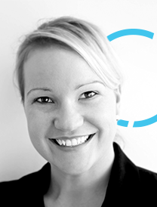
Kellie Northwood board officer/women in print ceo/the real media collective
Notes:
I really do look forward to this discussion and so I introduce you to Kellie Northwood, Chief Executive Officer of The Real Media Collective, and incoming CEO of the Print & Visual Communications Association, and Board Officer of Women in Print. Kellie is well-known across our industry and is a firm advocate of positioning our industry for a sustainable and strong future, this topic is part of that future and Kellie will share with us all this morning the facts and figures behind gender equality some which may surprise you, an so without further ado I hand you over to Kellie Northwood.
<HOLD SLIDE>
<KN TO RUN INTRO TO TOPIC>

Slide 5
gender diversity increases profits
gender-diverse companies are 48% more likely to outperform the least gender-diverse companies.
companies in the top quartile for gender diversity on their executive teams are 21% more likely to outperform companies in the fourth quartile.
women manage differently and deliver team performance. Female managers make more consistent actions in ensuring the wellbeing of their teams.
female executives reduce team absenteeism. Female leaders are up to twice as likely to spend substantial time on Diversity, Equity and Inclusion
Notes:
The research is clear and the facts cannot be disputed: Gender-diversity in workplaces = more profits.
McKinsey & Company, the largest gender diverse research report globally, has found:
gender-diverse companies are 48% more likely to outperform the least gender-diverse companies. Outperform across profitability, customer retention, brand value and operational efficiency targets.
companies in the top quartile for gender diversity on their executive teams are 21% more likely to outperform companies in the fourth quartile – this equals profits. The fact is as simple as that – companies with higher female leadership balance are more profitable.
women manage differently and deliver team performance. Female managers make more consistent actions in ensuring the wellbeing of their teams, including checking in on their team members, helping them manage their workloads, and providing support for team members who are dealing with burnout or navigating work–life challenges.
female executives reduce team absenteeism. Female leaders are up to twice as likely to spend substantial time on Diversity, Equity and Inclusion. This leads to more satisfied team members, reduced sick leave, increased tenure, increases loyalty to company culture and improved productivity. McKinsey has also reported that women demonstrate five out of nine types of leadership behaviour, more often than men, that improve organisational performance, for example, intellectual stimulation, inspiration, talent development and participative decision making.
These statistics are important for all leaders and emerging talent, male and female, to understand so we can build stronger businesses across our industry with increased focus on gender-diversity. More successful businesses with increased diversity, increased inclusivity and increased job satisfaction will contribute to a more sustainable and future-proofed print industry. If we as the Women in Print community can understand these important facts, we can then communicate them throughout industry together.

Slide 6
gender equality in print
Attractive primary carer options for women is also low in the print industry. All industry offering of paid parental leave is 54.6% compared to 23.1% in the print industry.
Workplace Gender Equality Agency, Australia, 2022.
Workplace Gender Equality Agency, Australia, 2022.
Notes:
This data is from the Workplace Gender Equality Agency or WGEA, they are an Australian Government agency and companies with a turnover greater than $100M are required to report. Across our industry, the majority of those reporting are the larger print groups, who because of private equity ownership or public listing have existing gender equality policies in place. So, I’m suggesting, these figures are the best representation of our industry and I would go even further to suggest that if we have all of industry report on this numbers, our figures wouldn’t be as strong.
That said, when reviewing the Workplace Gender Equality Agency across Australia, the print industry has some success to report in gender equality reporting.
Across Australia the gender split is 51.0% women and 49.0% men working. In the print industry it is a 33.2% women and 66.8% men split. Manufacturing is 27.2% women and 72.8% Men, so we are performing quite well – better than I expected actually. That said, we are classified as a ‘Male-Dominated’ Industry.
When looking into the gender pay gap, we find a difference between the Manufacturing average at 11.8% and 17.3% for print. Still better than the national average which is 19.7%.

Slide 7
gender equality in print
Workplace Gender Equality Agency, Australia, 2022.
Notes:
Paid primary or parental leave – 16.7% in our industry are paid a form of primary paid carer’s leave, compared to 38.7% across the Manufacturing sector more broadly and 54.6% as the national average. We are well below where we need to be, and I would point out here again that this reporting is from the largest print groups in the country – some of which are managing under EBAs which carry carer’s leave. If we want to attract more women and more talent into our industry to build our profitability, we need to address how attractive we make our industry to women – we need to shift our minds and our thinking to not shy away from work life balance working arrangements, rather embrace how we can build these models to suit our businesses and improve productivity.
When looking to female leadership or CEOs, of Key Management Personnel and Director roles we are most notably distanced with Other Industries. 19.4% across all industries compared to 7.1% for the print industry for CEOs and the numbers continue with key managers 34.5% for all or 24.8% for manufacturing and our industry 14.9%.
How can we be a more profitable industry if we do not address these differences? Not only between the gender gap, but more, our industry’s gap to the rest of the country? Should we do anything at all? Should we just stay male dominated and accept it is what it is? How does this relate to skills & training? How does this relate to our need to attract new talent to our industry? Well to start the discussion to answer these questions, let’s get our panel up.

Slide 8
an industry framework
attract
recruit
train & develop
retain
evaluate

Slide 9
gender equality in print
Sandy Aspinall Director – Creative Juice Deputy Chair and SA Patron – Women in Print
Tony Bertrand National Marketing Manager – Ball & Doggett
Deputy Chairman – APIA
Board Officer – TRMC
Charlotte Fountain Emerging 50 Winner – 2021 Graphic Designer – Worldwide Print, Hamilton
Mark Moro National Sales Manager – Ricoh Australia
Notes:
<INTRODUCTIONS FROM KN>
Thank you all, well let’s start somewhere – before we spend some time discussing this topic, should we bother? Does this apply to our industry (TB)?
(SA) – across recruitment, if the roles are best fit for men, should we just stay male dominated and accept it is what it is?
So, we agree we should be addressing this topic, how does this relate to other talent attraction and retention issues? And should we be building better skills & training programs to attract women into our industry? (MM)
Charlotte, you’ve completed an apprenticeship within our industry and are working in the industry now perfecting your craft, how did you come into our industry? And once in an apprentice, how did you find that experience? Did you have any industry support? Could we/should we be doing better?
How can we be a more profitable industry if we do not address these differences? Not only between the gender gap, but more, our industry’s gap to the rest of the country? How does this relate to skills & training? How does this relate to our need to attract new talent to our industry?

Slide 10
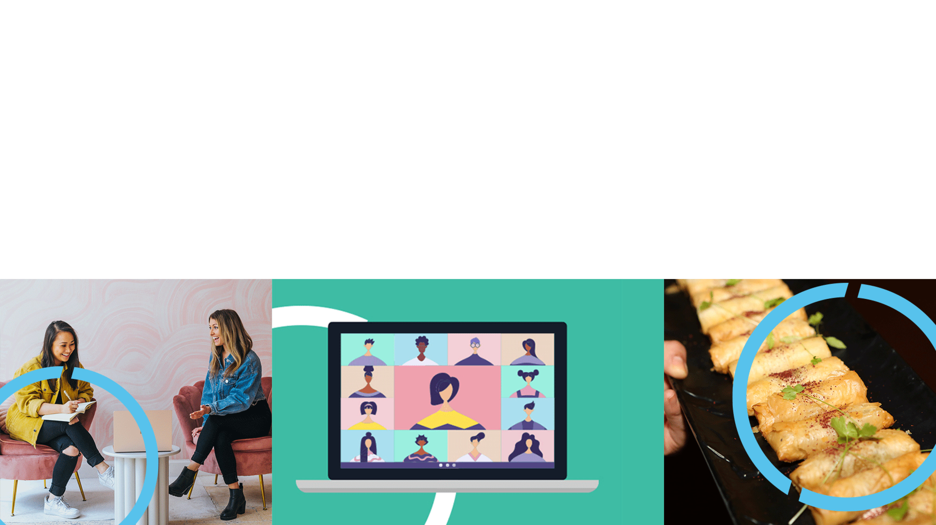
open discussion
Notes:
DOROTHY DIXERS
Kellie, you and I have discussed quotas across our industry and it is a big topic across diversity issues, what do you and the panel feel about quotas? Should we start building these into our policies? (Zaidee Jackson – B&D)
Should staff be leading these discussions with their managers/owners or should the managers/owners be providing space to discuss things like this? (Sharon Dowsey – Spicers)
What about other aspects of diversity? Sexuality, race, religion? How do we build these into the discussion and/or industry policy? (Mitch Mulligan – Bottcher)
How does this relate to staff coming on VISAs? Skilled or Unskilled? Do we think government will implement a policy across VISAs and gender? (Andrew Gasper – OVT)
The stats across the commercial benefit and ‘good business practice’ to implement a gender policy are impressive? Although do these simply apply to large corporates? How could they apply to a smaller business? (Janet Maitland – Image Magazine)

Slide 11
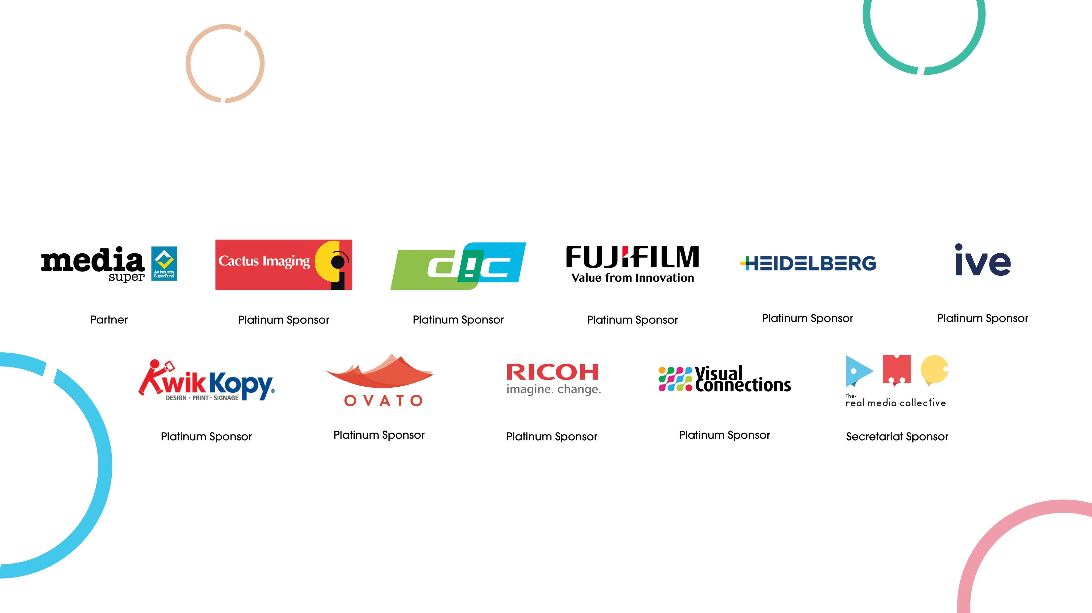
our supporters
Notes:
Media Super, a long term partner across the industry and to Visual Connections for their funding to bring this event together today. And to our platinum sponsors:
Heidelberg one of our founding sponsors, DIC a long-standing sponsor for many years, Cactus Imaging who never hesitates to support female leadership and growth. Fujifilm, IVE Group, Kwik Kopy, Ovato and Ricoh offering industry leadership support. And to The Real Media Collective team are instrumental behind this as Secretariat. Thank you.

Slide 12
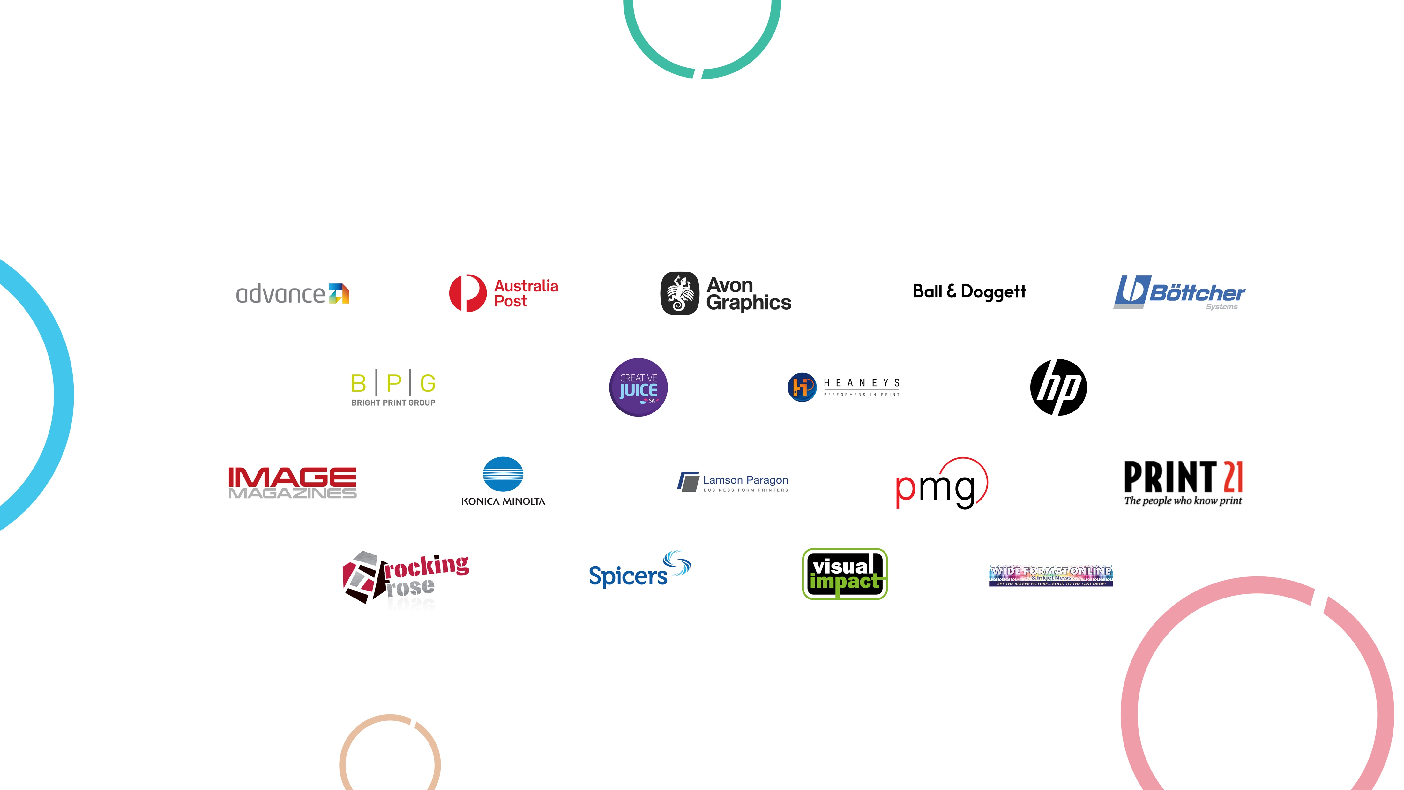
our supporters
Notes:
Thank also to all our Associate Partners for their financial sponsorship and also their attendance to the breakfasts right across the country.
Particularly our Patron and Board companies – Advance, Bright Print Group, Creative Juice, Heaney’s Performers in Print, IVE Group and Rocking Rose. Who allow our Patrons and Board time to attend many meetings, events and time commitments to bring the Women in Print community together. Not once have any of our Patrons been challenged for their time and commitment from their companies and this is a real testament to the organizations they work for.

Slide 13
thank you
Notes:
Thank you all for attending, to our panellists for giving up their time – it’s not easy to do that. To our sponsors Media Super and Visual Connections.…… and our Women in Print Board and Patrons – Susan Heaney, Sandy Aspinall, Lisa Blachut, Debbie Burgess, Rita Karagiannis and our newest Patron from QLD, Morag Pugh. To the trade media in the room – without your support, all of you we couldn’t share these messages, I really do appreciate the coverage and exposure you provide, you’re all wonderful supporters of Women in Print and the industry more broadly.
And to all of you in the room thank you – take the information in front of you, continue the discussion with your colleagues and peers. We will be distributing this across the industry and keeping the discussion alive as we look to implementing an industry standard for all.
Thank you and have a good day.

